Slide 1
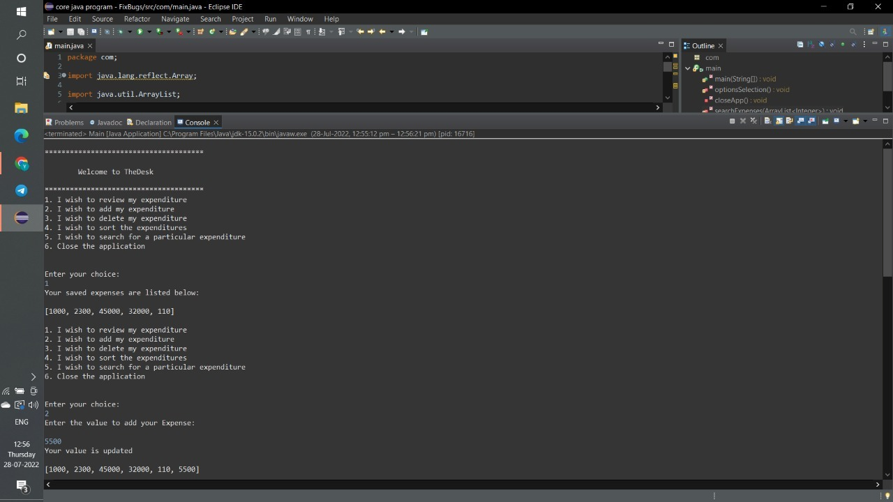
FIX BUGS PROGRAM SCREENSHOTS

Slide 2
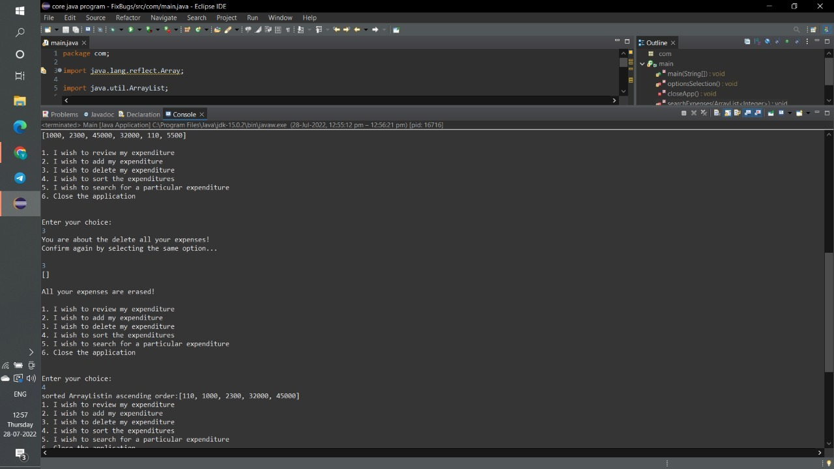

Slide 3
